Slide 1


<Esrat Jahan>
<17-09-2025>

Slide 2

Outline
Executive Summary
Introduction
Methodology
Results
Conclusion
Appendix

Slide 3
Executive Summary
Summary of methodologies
SpaceX Data Collection using API
SpaceX Data Collection with Web Scrapping
SpaceX Data Wrangling
SpaceX Exploratory Data Analysis Using SQL
SpaceX EDA Data Visualization Using Python
SpaceX Interactive Visual Analytics of Launch Sites with Folium and Plotly Dash
SpaceX Machine Learning Landing Prediction
Summary of all results
Exploratory Data Analysis
Interactive Visual Analytics and Dashboard
Predictive Analysis Using Classification Model (LR,KNN,SVM,DT models)

Slide 4
Introduction
Project background and context
SpaceX advertises Falcon 9 rocket launches on its website with a cost of 62 million dollars; other providers cost upwards of 165 million dollars each, much of the savings is because SpaceX can reuse the first stage. Therefore, if we can determine if the first stage will land, we can determine the cost of a launch. This information can be used to identify if other alternative company can bid against SpaceX for a rocket launch.
Problems you want to find answers
In this project, we will predict if the Falcon 9 first stage will land successfully and will reuse the first stage b using data from Falcon 9 rocket launches advertised on its website.

Slide 5

Section 1

Slide 6
Methodology
Executive Summary
Data collection methodology:
Describe how data was collected
Perform data wrangling
Describe how data was processed
Perform exploratory data analysis (EDA) using visualization and SQL
Perform interactive visual analytics using Folium and Plotly Dash
Perform predictive analysis using classification models
How to build, tune, evaluate classification models

Slide 7
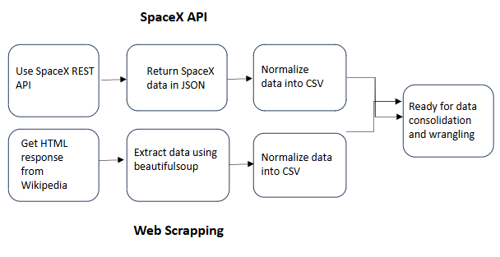
Data Collection
How SpaceX Falcon 9 data were collected.
Data were collected using SpaceX API by making get request. A series of helper functions were defined that will helped to use the API to extract information using identification numbers in the launch data.
To make the requested JSON results more consistent, the SpaceX launch data was requested ad parsed using get request and then converted into Pandas Data frame.
Performed web scrapping to collect Falcon 9 historical launch records from a Wikipedia page titled List of Falcon 9 and Falcon Heavy launches. Using BeautifulSoup and request libraries data were extracted from the Falcon 9 HTML Table from the Wikipedia page. Then I parsed the table and converted it into Panadas Data frame

Slide 8
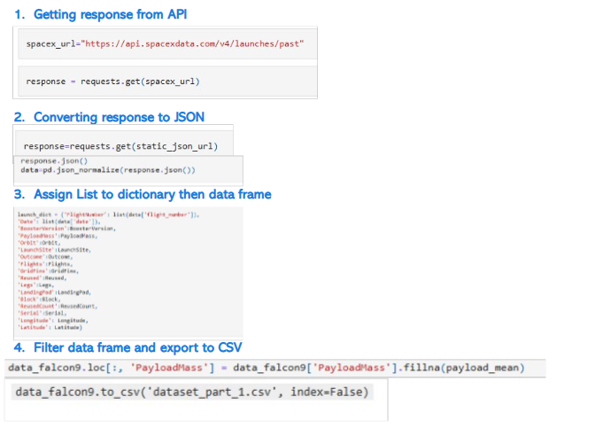
Data Collection – SpaceX API
Data collection with SpaceX REST calls
Github Link:Space-X-Falcon-9-landing-prediction/spacex-data-collection-api.ipynb at main · esratisha/Space-X-Falcon-9-landing-prediction

Slide 9
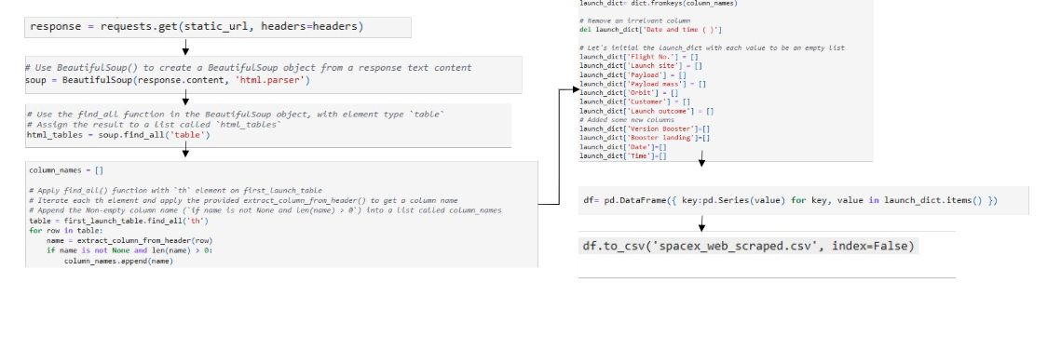
Data Collection - Scraping
Web scraping process
Github Link:Space-X-Falcon-9-landing-prediction/spacex-webscraping.ipynb at main · esratisha/Space-X-Falcon-9-landing-prediction

Slide 10
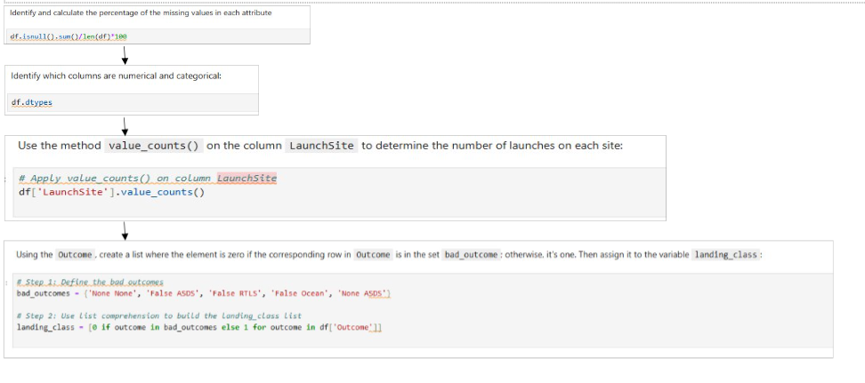
Data Wrangling
Identify and calculate the percentage of the missing values in each attribute
Identify which columns are numerical and categorical:
Use the method value_counts() on the column LaunchSite to determine the number of launches on each site:
Using the Outcome, create a list where the element is zero if the corresponding row in Outcome is in the set bad_outcome; otherwise, it's one. Then assign it to the variable landing_class
Space-X-Falcon-9-landing-prediction/spacex-Data wrangling.ipynb at main · esratisha/Space-X-Falcon-9-landing-prediction

Slide 11
EDA with Data Visualization
Charts plotted to analyze the data
Visualize the relationship between Flight Number and Launch Site
Visualize the relationship between Payload Mass and Launch Site
Visualize the relationship between success rate of each orbit type
Visualize the relationship between FlightNumber and Orbit type
Visualize the relationship between Payload Mass and Orbit type
Visualize the launch success yearly trend
Github Link:Space-X-Falcon-9-landing-prediction/spacex-EDA.ipynb at main · esratisha/Space-X-Falcon-9-landing-prediction

Slide 12
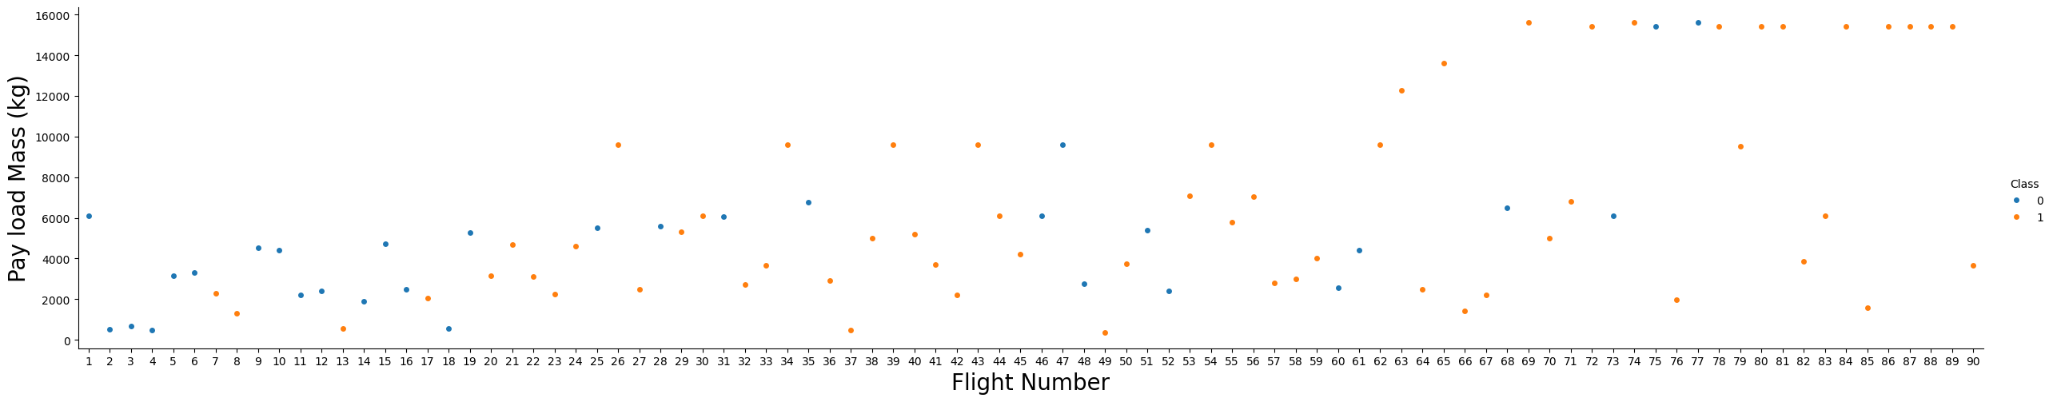
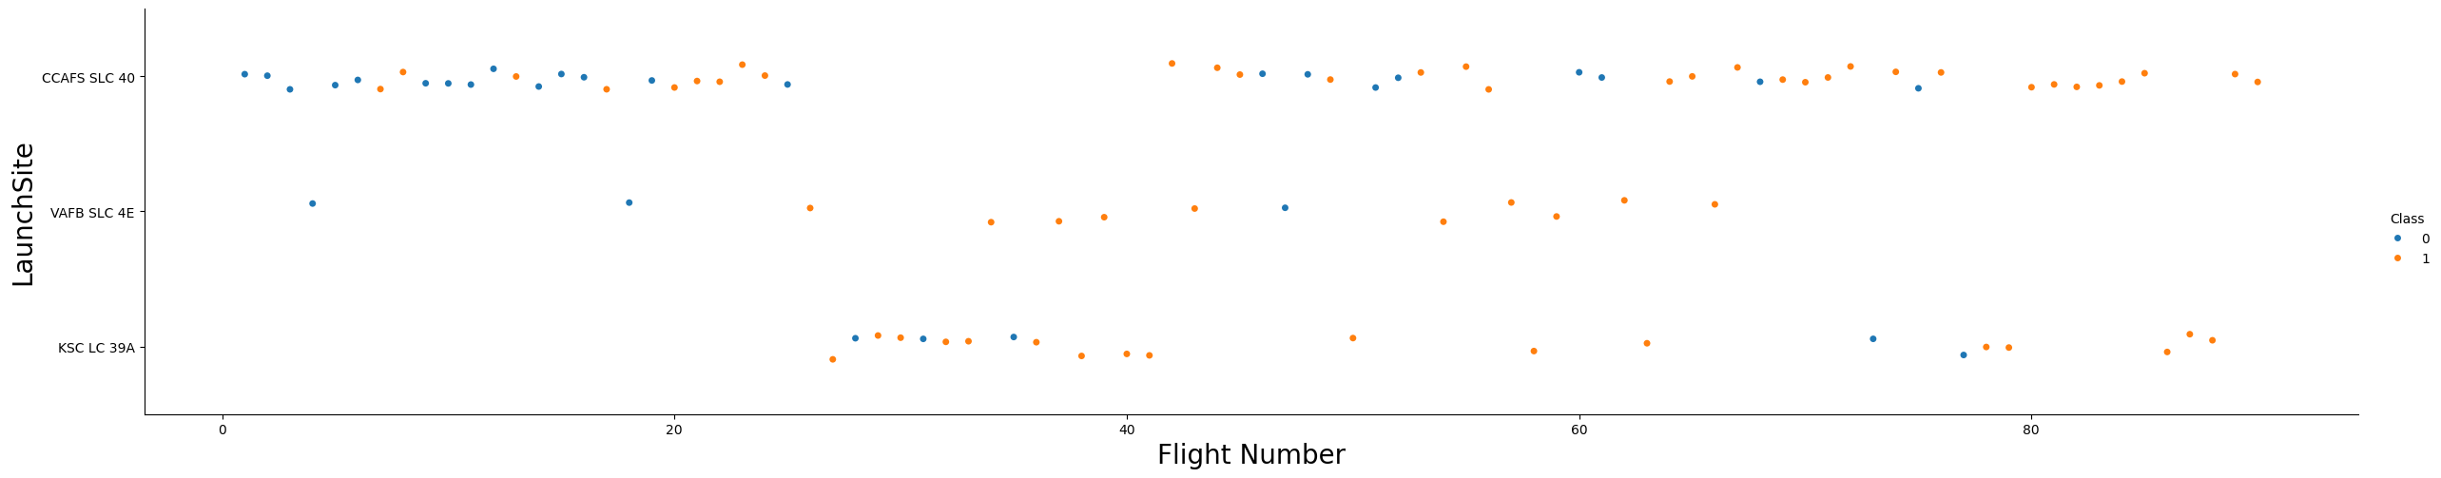
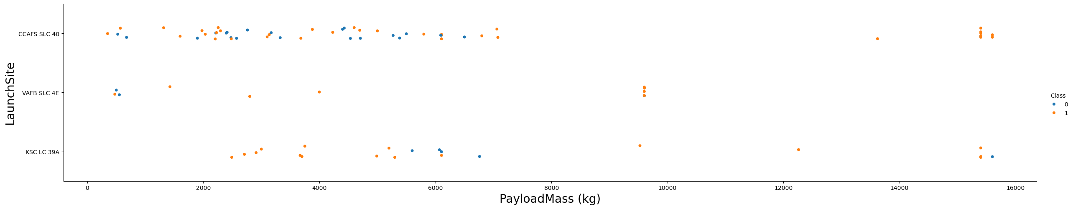
EDA with Data Visualization

Slide 13
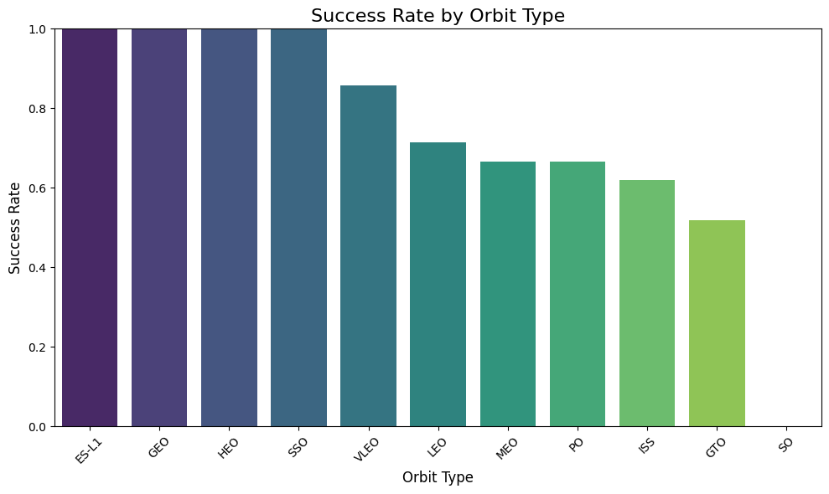
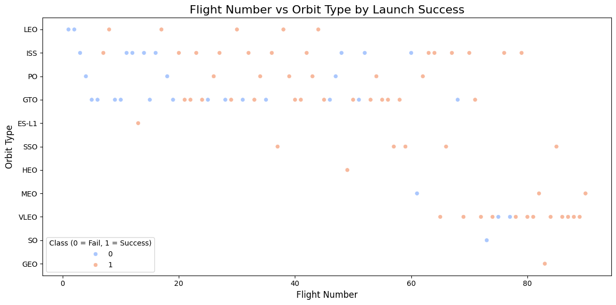
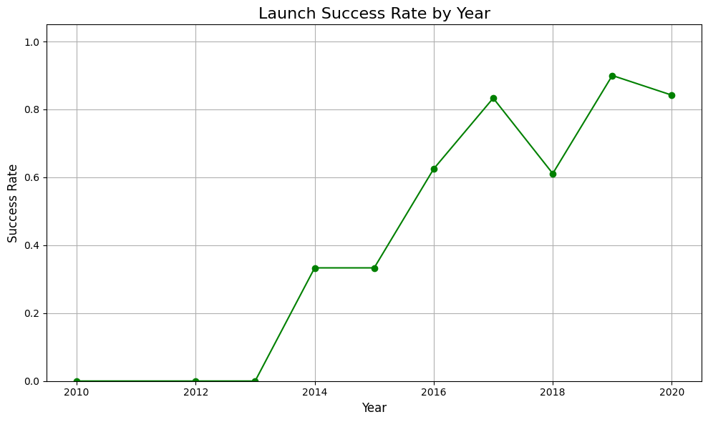
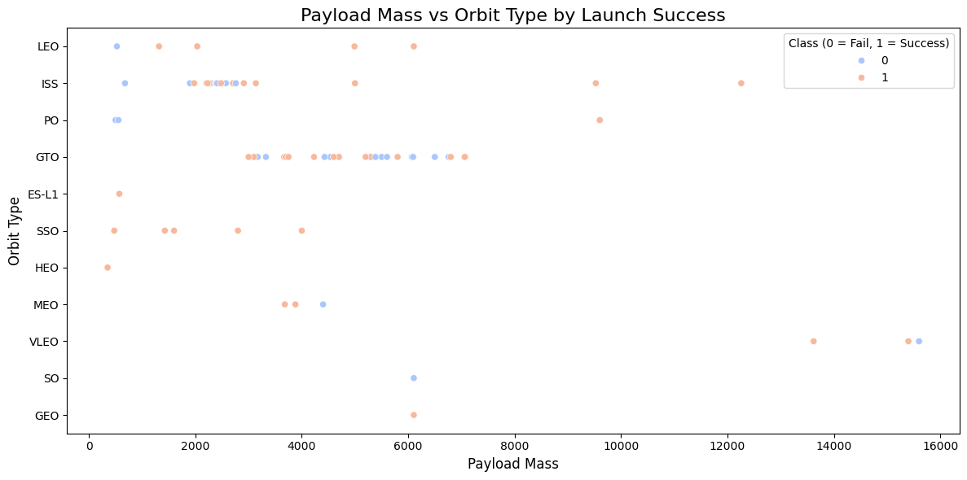
EDA with Data Visualization

Slide 14
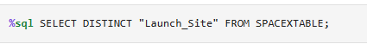
EDA with SQL
The following SQL queries were performed
Display the names of the unique launch sites in the space mission
Display 5 records where launch sites begin with the string 'CCA
Display the total payload mass carried by boosters launched by NASA (CRS)
Display average payload mass carried by booster version F9 v1.1
List the date when the first succesful landing outcome in ground pad was acheived.
Add the GitHub URL of your completed EDA with SQL notebook, as an external reference and peer-review purpose

Slide 15
EDA with SQL
List the names of the boosters which have success in drone ship and have payload mass greater than 4000 but less than 6000
List the total number of successful and failure mission outcomes
List all the booster_versions that have carried the maximum payload mass, using a subquery with a suitable aggregate function.
List the records which will display the month names, failure landing_outcomes in drone ship ,booster versions, launch_site for the months in year 2015.
Rank the count of landing outcomes (such as Failure (drone ship) or Success (ground pad)) between the date 2010-06-04 and 2017-03-20, in descending order.
Github Link: Space-X-Falcon-9-landing-prediction/spacex-eda-sql-sqllite.ipynb at main · esratisha/Space-X-Falcon-9-landing-prediction

Slide 16
Build an Interactive Map with Folium
Created folium map to mark all the launch sites on the map and created map object such as markers, circles, lines to mark the success or failure of launches for each launch site
Analysed the distances between a launch site to its proximities
GitHub URL Space-X-Falcon-9-landing-prediction/spacex-launch_site_location.ipynb at main · esratisha/Space-X-Falcon-9-landing-prediction

Slide 17
Build a Dashboard with Plotly Dash
Built an interactive dashboard application with Plotly dash by:
Added a dropdown list to enable Launch Site selection
Added a pie chart to show the total successful launches count for all sites
Added a slider to select payload range
Added a callback function for `site-dropdown` as input, `success-pie-chart` as output
Added a callback function for `site-dropdown` and `payload-slider` as inputs, `success-payload-scatter-chart` as output
GitHub URL Space-X-Falcon-9-landing-prediction/Interactive Visual Analytics and Dashboard.ipy at main · esratisha/Space-X-Falcon-9-landing-prediction

Slide 18
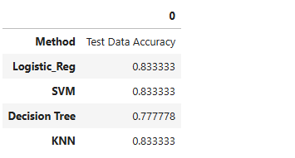
Predictive Analysis (Classification)
Created a NumPy array from the column Class in data, by applying the method to_numpy() then assign it to the variable Y,make sure the output is a Pandas series (only one bracket df['name of column']).
Standardized the data in X then reassign it to the variable X using the transform provided below.
Used the function train_test_split to split the data X and Y into training and test data. Set the parameter test_size to 0.2 and random_state to 2. The training data and test data should be assigned to the following labels.
In order to find the best machine learning model that would performs best using the test data between SVM,Classificatio trees, KNN and logistic regression
Created an object for each of the algorithm then create a GridSearchCV object logreg_cv with cv = 10. Fit the object to find the best parameters from the dictionary parameters.
Calculated the accuracy on the test data using the method score
GitHub URL Space-X-Falcon-9-landing-prediction/SpaceX_Machine Learning Prediction_Part_5 (2).ipynb at main · esratisha/Space-X-Falcon-9-landing-prediction

Slide 19
Results
Exploratory data analysis results
Interactive analytics demo in screenshots
Predictive analysis results

Slide 20

Section 2

Slide 21
Flight Number vs. Launch Site
Scatter plot of Flight Number vs. Launch Site
Launches from the site of CCAFS 40 are significantly higher than launches from other sites

Slide 22
Payload vs. Launch Site
Payload vs. Launch Site
Majority of the payloads with lower mass have been launched from CCAFS SLC 40

Slide 23
Success Rate vs. Orbit Type
Bar chart for the success rate of each orbit type
The orbit type ES-L-1, GEO, HEO, SSO have the highest success rate

Slide 24
Flight Number vs. Orbit Type
Show a scatter point of Flight number vs. Orbit type
It can be observed that in the LEO orbit, success seems to be related to the number of flights. Conversely, in the GTO orbit, there appears to be no relationship between flight number and success.

Slide 25
Payload vs. Orbit Type
Show a scatter point of payload vs. orbit type
With heavy payloads the successful landing or positive landing rate are more for Polar,LEO and ISS.
However, for GTO, it's difficult to distinguish between successful and unsuccessful landings as both outcomes are present.

Slide 26
Launch Success Yearly Trend
Show a line chart of yearly average success rate
The success rate since 2013 kept increasing till 2020

Slide 27
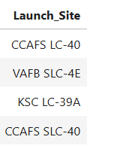
All Launch Site Names
Names of the unique launch sites

Slide 28
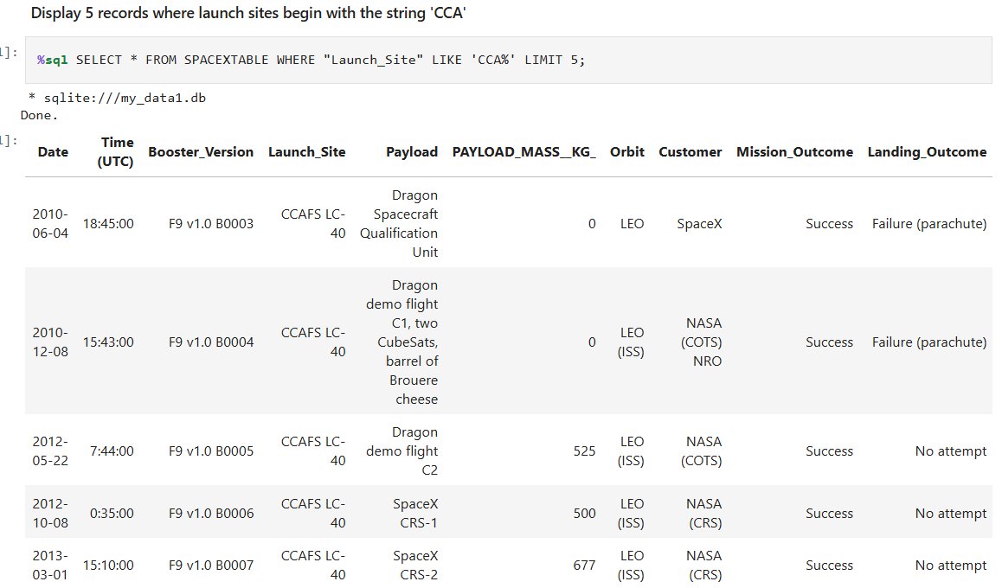
Launch Site Names Begin with 'CCA'
Find 5 records where launch sites begin with `CCA`

Slide 29
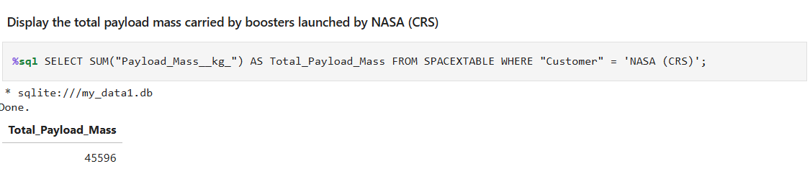
Total Payload Mass
The total payload carried by boosters from NASA

Slide 30
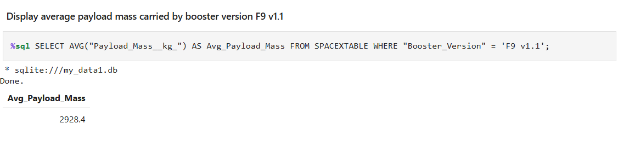
Average Payload Mass by F9 v1.1
The average payload mass carried by booster version F9 v1.1
Present your query result with a short explanation here

Slide 31
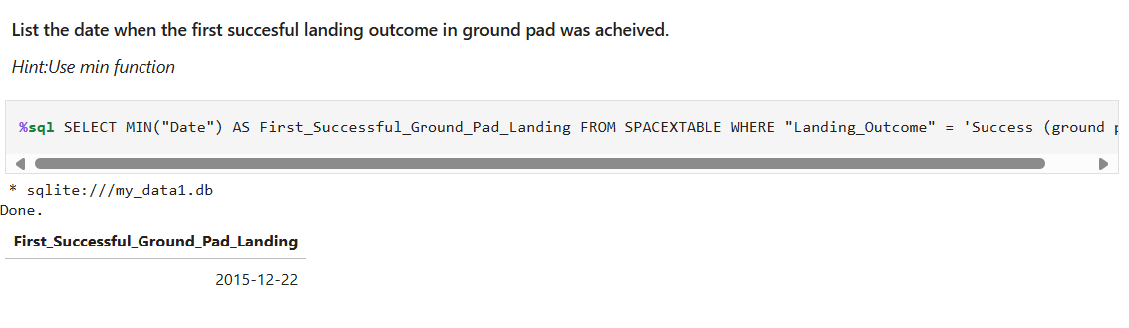
First Successful Ground Landing Date
The dates of the first successful landing outcome on ground pad

Slide 32
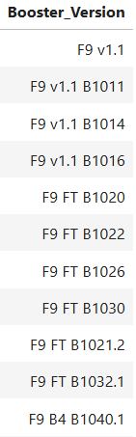
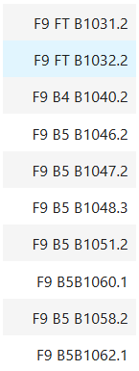
Successful Drone Ship Landing with Payload between 4000 and 6000
List the names of boosters which have successfully landed on drone ship and had payload mass greater than 4000 but less than 6000
%sql SELECT DISTINCT "Booster_Version" FROM SPACEXTABLE WHERE "Mission_Outcome" = 'Success' AND "PAYLOAD_MASS__KG_" > 4000 AND "PAYLOAD_MASS__KG_" < 6000;

Slide 33
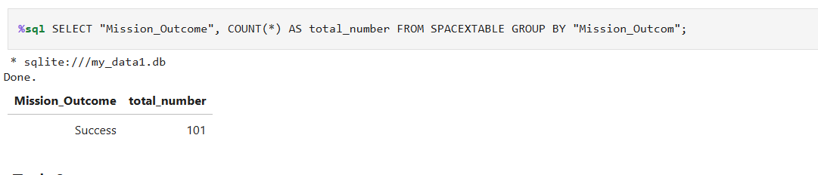
Total Number of Successful and Failure Mission Outcomes
The total number of successful and failure mission outcomes
Present your query result with a short explanation here

Slide 34
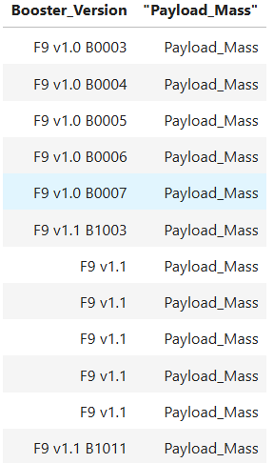
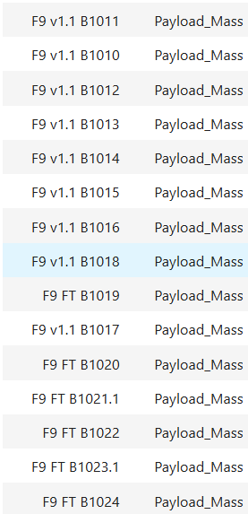
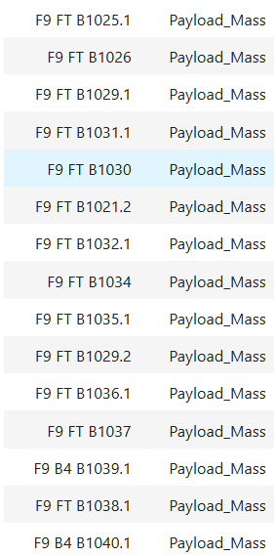
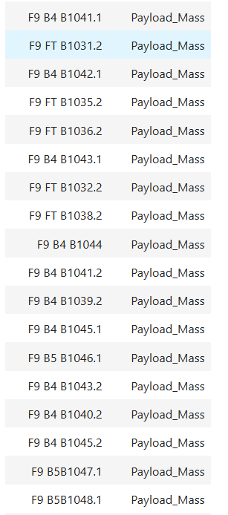
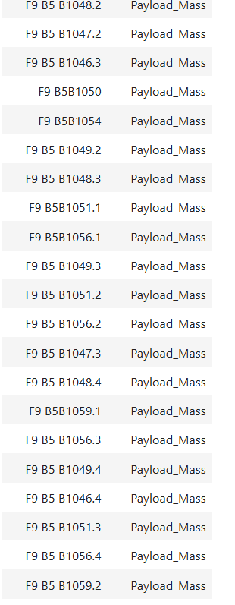
Boosters Carried Maximum Payload
List the names of the booster which have carried the maximum payload mass
%sql SELECT "Booster_Version", "Payload_Mass" FROM SPACEXTABLE WHERE "Payload_Mass" = (SELECT MAX("Payload_Mass") FROM SPACEXTABLE);

Slide 35
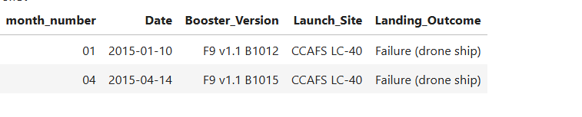
2015 Launch Records
List the failed landing_outcomes in drone ship, their booster versions, and launch site names for in year 2015
%sql SELECT strftime('%m', Date) AS month_number, strftime('%Y-%m-%d', Date) AS Date, Booster_Version, Launch_Site, Landing_Outcome FROM SPACEXTABLE WHERE Landing_Outcome = 'Failure (drone ship)' AND strftime('%Y', Date) = '2015';

Slide 36
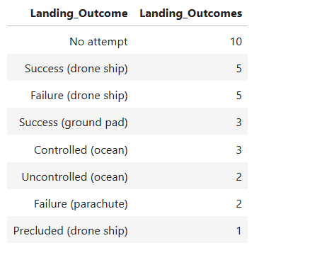
Rank Landing Outcomes Between 2010-06-04 and 2017-03-20
Rank the count of landing outcomes (such as Failure (drone ship) or Success (ground pad)) between the date 2010-06-04 and 2017-03-20, in descending order

Slide 37

Section 3

Slide 38
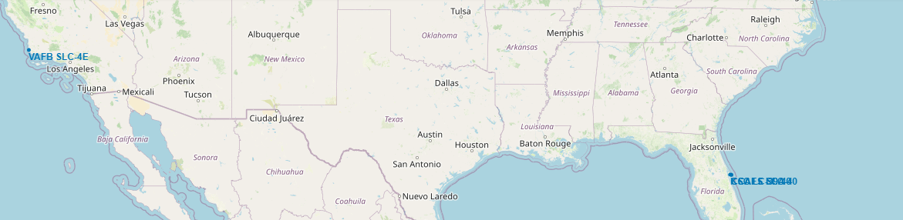
Launch Sites Map
All launch sites are in proximity to the Equator, located southwards of US map. They are close proximity to the coasts

Slide 39
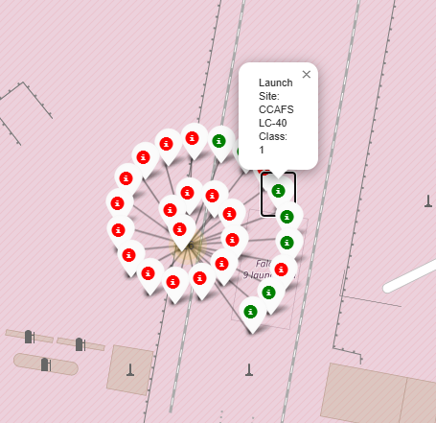
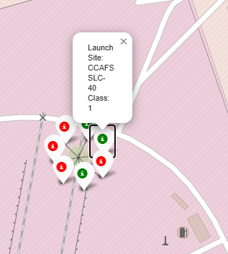
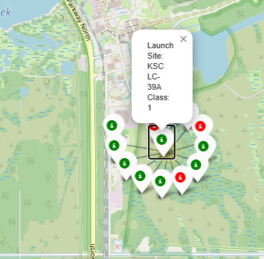
Launch outcomes for each sites with color marker
In the Eastern Coast Launch site KSC LC-39A has high success rates compared to CCAFS SLC-40 and CCAFS LC-40

Slide 40
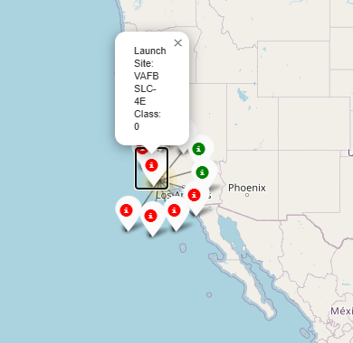
Launch outcomes for each sites with color marker
In the west coast Launch site VAFB SLC-4E has relatively lower success rates compared to east coast

Slide 41
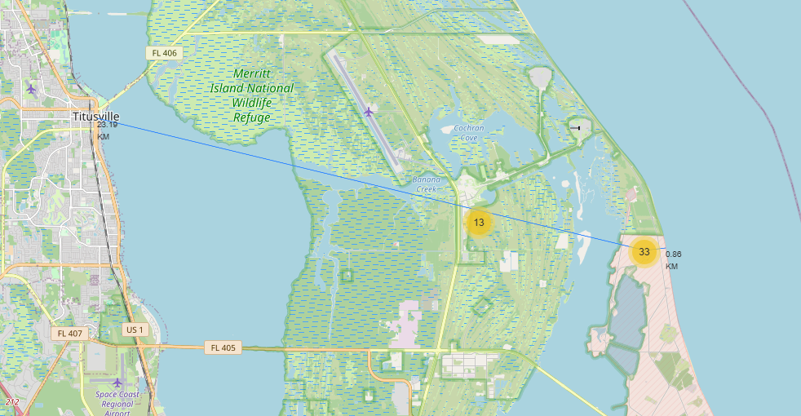
Distance between a launch site to its proximities
Launch Site CCAFS SLC-40 closest to highway (Washington Ave) is 23.19km

Slide 42
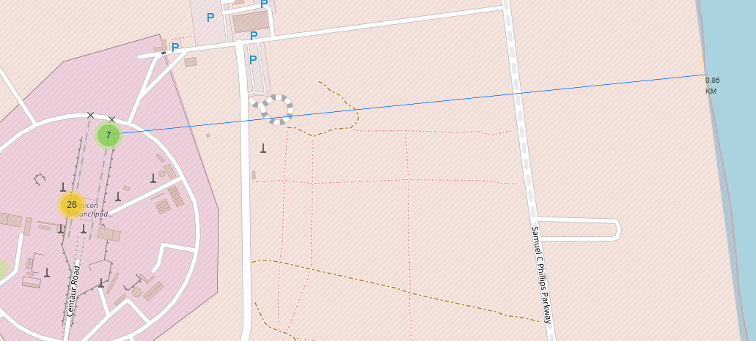
Distance between a launch site to its proximities
Launch Site CCAFS SLC-40 proximity to coastline is 0.86km

Slide 43

Section 4

Slide 44
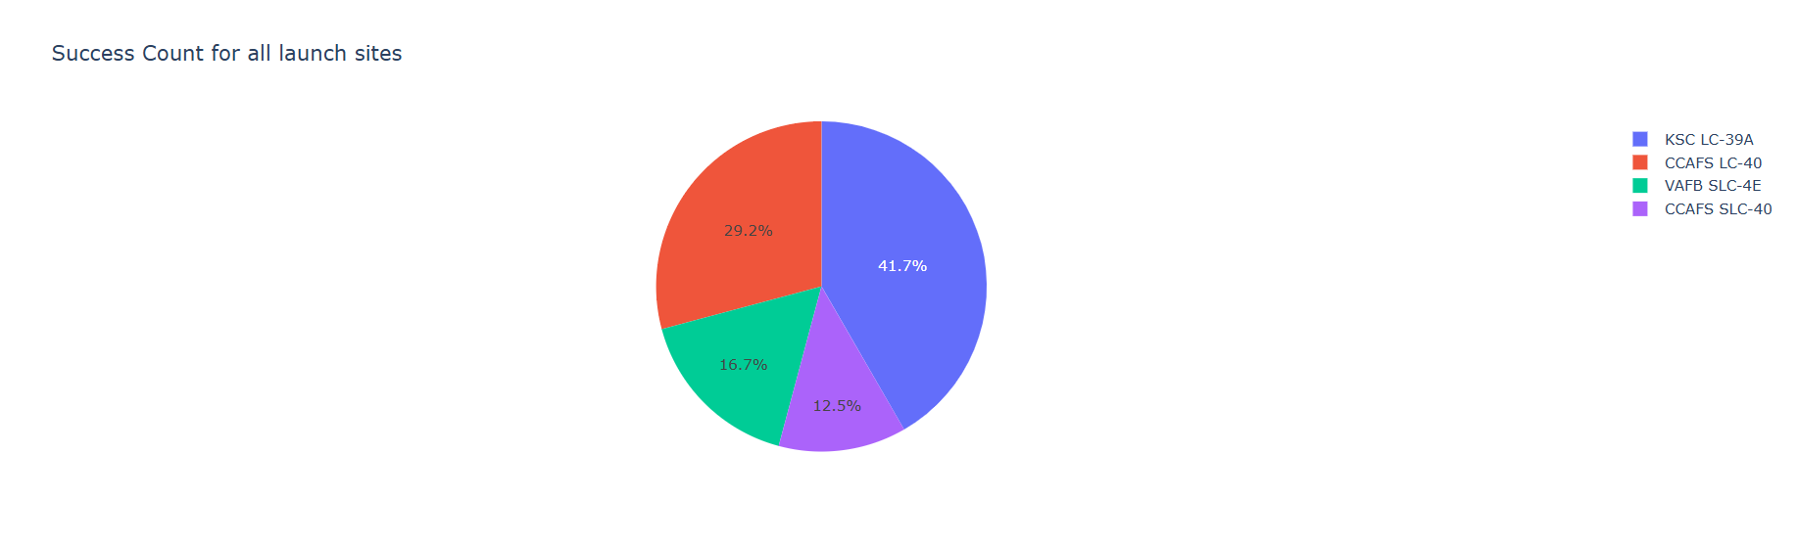
Launch success count for all sites
Launch success count for all sites, in a piechart
Launch site KSC LC-39A has the highest launch success rate at 42% followed by CCAFS LC-40 at 29% , VAFB SLC-4E at 17% and CCAFS SLC-40 with a success rate of 13%

Slide 45
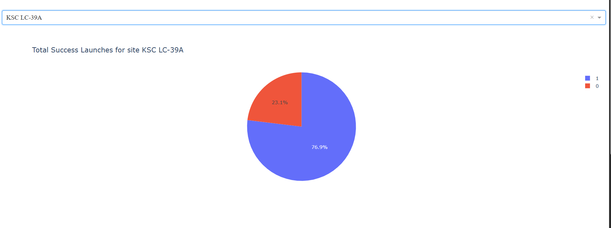
piechart for the launch site with highest launch success ratio
Launch site KSC LC-39A has the highest launch success ratio. 73% success and 27% failed launches

Slide 46
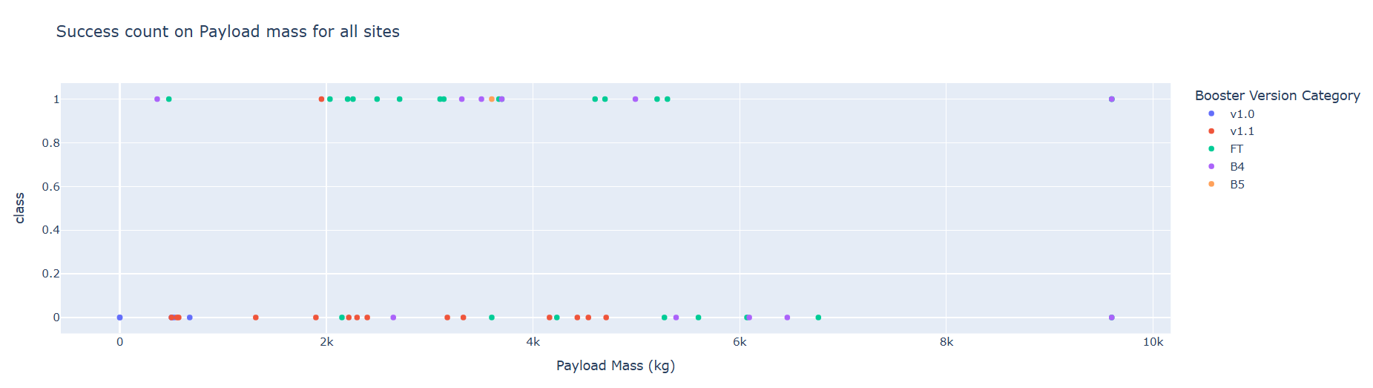
Payload vs. Launch Outcome scatter plot for all sites
Foe launch site CCAFS LC-40 the booster version FT has the largest success rate

Slide 47

Section 5

Slide 48
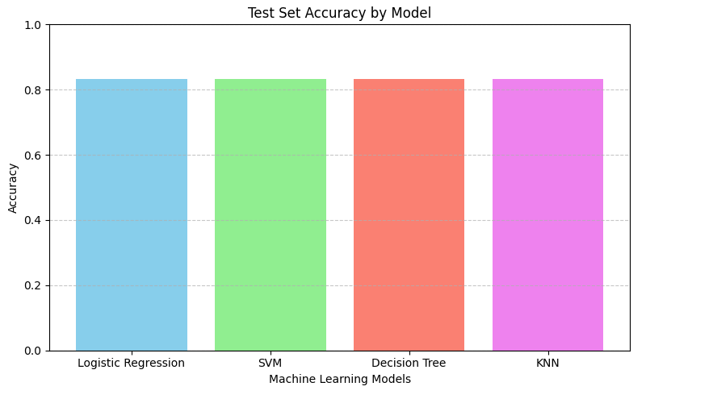
Classification Accuracy
All the model has accuracy of 0.83

Slide 49
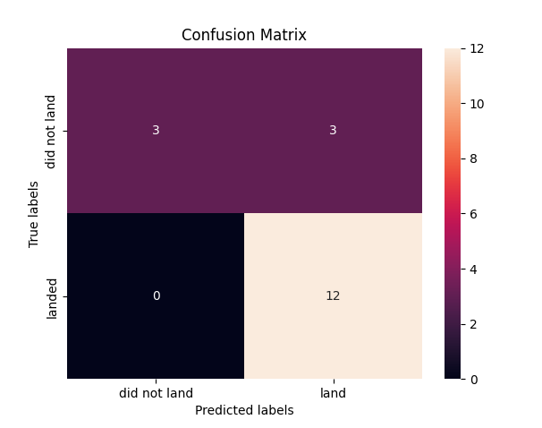
Confusion Matrix
All the 4 classification model had the same confusion matrix. The major problem was false positives for all the models

Slide 50
Conclusions
Different launch sites different success rates. Launch site KSC LC-39A has the highest success rate of 77%.
As the flight number increases in each of the lunch sites, the success rate also increases.
There is no rocket launched for heavyload mass greater than 10000 for VAFB-SLC
The orbit type ES-L-1, GEO, HEO, SSO have the highest success rate of 100%
With heavy payloads the successful landing or positive landing rate are more for Polar,LEO and ISS.
However, for GTO, it's difficult to distinguish between successful and unsuccessful landings as both outcomes are present.
The success rate since 2013 kept increasing till 2020

Slide 51


